Slide 1


Slide 2




CODE VERSE HACKATHON 2025
Problem Statement Title - Real-Time Weapon Detection: Enhancing Public Safety through AI-Powered Surveillance
Team Name - Team Diamonds
Team Members -
Onkar Takmoge
Anas Pathan
Aditya Gundeli
Aryan Kota

Slide 3







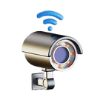




IDEA TITLE
Idea / Solution / Prototype
Innovation & Uniqueness
AI-Powered Detection: Use deep learning (YOLOv8/YOLOv9) to automatically identify weapons (pistol, knife, rifle) from CCTV/IP camera feeds in real time.
Smart Alerting System: Generate instant alerts with weapon type, confidence score, and snapshot, while reducing false positives through tracking and multi-frame confirmation.
Prototype Dashboard: A working demo showcasing live video overlays, recent alert history, and real-time notifications (Slack/Telegram/Email) for security staff.
Proactive Security: Detects weapons instantly to
prevent threats before escalation.
Smart Alerting: Multi-frame tracking ensures reliable alerts with minimal false positives.
Edge-Optimized & Privacy-First: Runs on Jetson/Coral with face blurring and on-prem deployment.
Scalable Integration: Easily connects with multiple cameras and existing security systems.
Solution Approach
Flow of Construction Activitiest and ML Model Used:
Weapon Detection Pipeline: Capture CCTV/IP feeds, preprocess frames, and detect weapons using YOLOv7/YOLOv8 models.
Smart Alerting: Apply tracking + multi-frame confirmation to minimize false positives and send real-time alerts with snapshots.
Dashboard Integration: Provide a centralized interface to monitor live feeds, view alert history, and manage notifications.
Input
(from camera)
Preprocessing (Frame Extraction
,Resizing)
YOLOv8
(Weapon
Detection)
Alert System
(Popup/slack
Notificaton)
Dashboard Update (Timestamp,Snapshot,Weapon Type

Slide 4











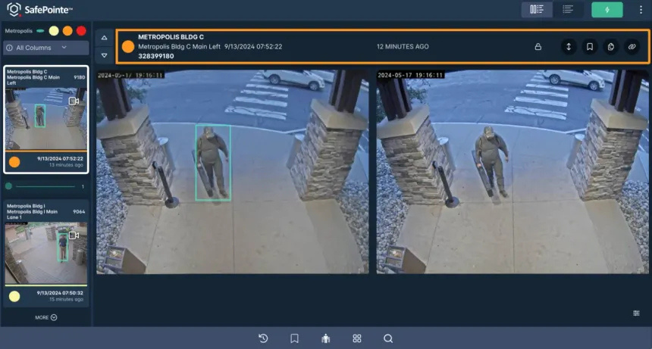
TECHNICAL APPROACH
⚙️ Methodology
Dataset Preparation
Collect CCTV images/videos (weapons + non-weapons)
Clean & preprocess (resize, enhance, noise removal)
Annotate weapons (guns, knives, rifles)
Split into Train / Validation / Test sets
Model Development
Train YOLOv7/YOLOv8 with transfer learning
Apply augmentation (low-light, occlusion, scaling)
Validate using mAP, Precision, Recall
Optimize & Quantize for edge devices (INT8/TensorRT)
System Integration
Connect to CCTV/IP camera feed (RTSP)
Real-time detection + object tracking (avoid duplicate alerts)
Dashboard with live feed, alerts, snapshots
Multi-channel alerts (popup, email, Telegram/Slack)
Night Mode for low-light conditions

Slide 5

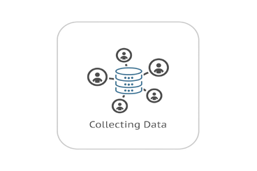
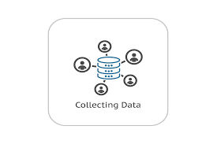















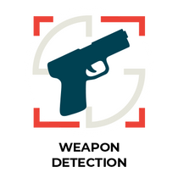


TECHNICAL APPROACH
Archetiture Veiw
Dataset Collection
Preprocessing
(Data Cleaning)
Manual
Annotations
Dataset
Splitting
Training
Data
Training Model
Yolov8
Track Weapon
Image Data
Validation data
TrainedModel
Warning (Sound Alerts)
NO
Video Data
Activate Night Mode?
YES
Detect Weapons
CCTV Footage
Activate Night Vission
Quantized Model
( Light Weight )

Slide 6




FEASIBILITY AND VIABILITY
Potential Challenges & Risks
Feasibility Analysis
Overcoming Challenge
Technological Feasibility :- Real-time weapon detection is achievable using pretrained YOLOv8 models and standard hardware.
Integration with Existing Systems: Easily integrates with CCTV and security dashboards for seamless deployment.
Scalability:- Easily scales from single-camera use to multi-camera security networks, supporting future AI-driven enhancements.
Accuracy Concerns:- Detection may face challenges in low light, crowded scenes, or with concealed weapons. Continuous model training with diverse datasets can improve reliability.
Image Quality Issues:- Low-resolution or blurry footage can reduce detection accuracy. Using high-quality cameras and preprocessing techniques can enhance results.
Data Privacy Concerns:- Handling surveillance footage must ensure secure storage and restricted access.Compliance with data protection laws is essential to maintain trust and legality.
Model Optimization :- Use transfer learning and lightweight architectures to ensure fast, accurate real-time detection.
Data Enhancement :- Train with diverse, high-quality datasets to handle varied environments and weapon types.
System Integration :- Design modular APIs for smooth deployment with existing CCTV and security systems.

Slide 7


IMPACT AND BENEFITS
Key Benefits
Impact
Real-time alerts with high accuracy.
AI-powered smart detection with minimal false alarms.
Centralized and user-friendly dashboard for multi-camera monitoring.
Privacy-first design with optional on-premises deployment.
Scalable across industries: defense, transport hubs, smart cities, enterprises.
Enhances public safety in schools, malls, and stations.
Builds community trust with safer environments.
Ensures ethical surveillance by focusing only on weapons.
Cuts costs by reducing large monitoring teams.
Prevents financial losses through crime reduction.
Creates new jobs in AI surveillance and security tech
Runs efficiently on low-power/edge devices.
Reuses existing CCTV setups, minimizing waste.
Supports smart city and sustainable infrastructure goals
Social Impact
Economic Impact
Environmental Impact

